Slide 1
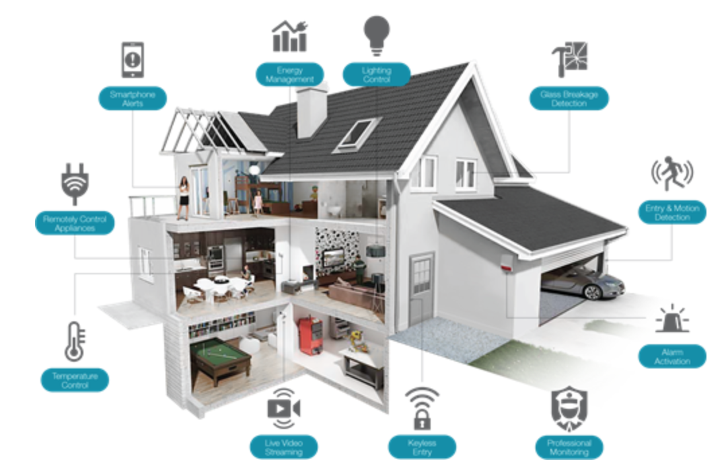
Building Smart-Home With Artificial Intelligence
Lecturer: Bùi Thi Thanh Thanh
Student: Hồ Gia Khánh

Slide 2

You are living in industry revolution 4.0. As you can see, technology go through your life, appears in everywhere, every time, it effects so much. Let’s make a comparison between the life of ten years ago and now. Technology constantly develop, beside, its revolution is very fast.

Slide 3
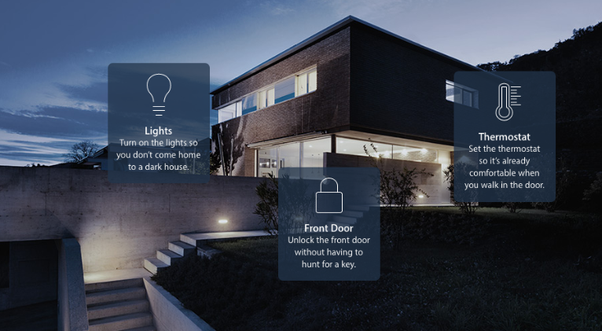
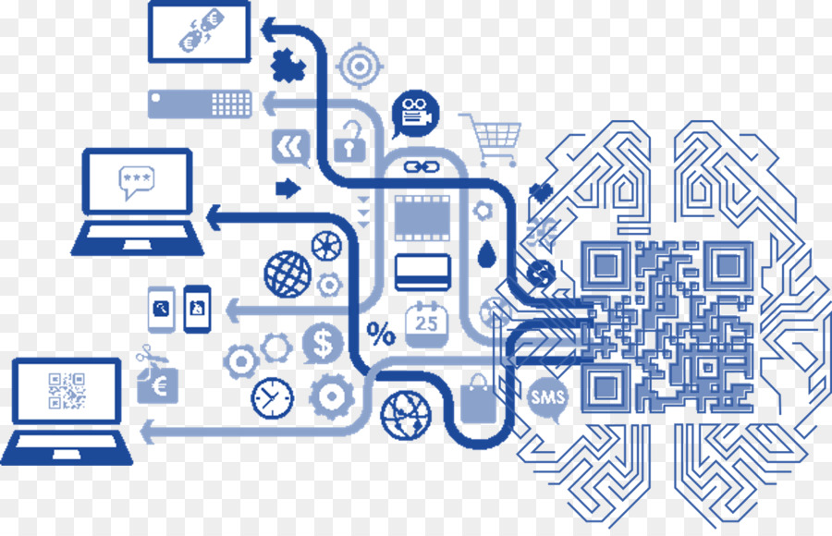
What is smart-home?
Smart-home is the home which is equipped with advanced automatic system for controlling the light, temperature, multimedia, security, curtains, doors and more function. It make the life more convenient, safer, more modern and contribute to using reasonable resources. Today smart-home just is remote controllable home, AI is not yet intervened in it. Well “Smart-home” is not exactly what it means. The real “smart-home” should have intervention of AI.

Slide 4
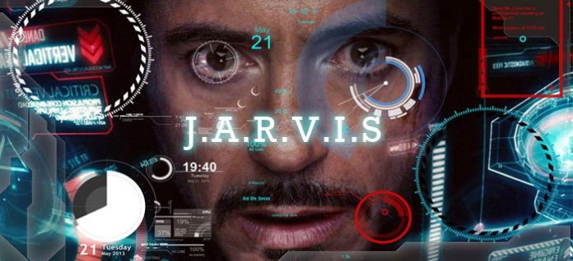
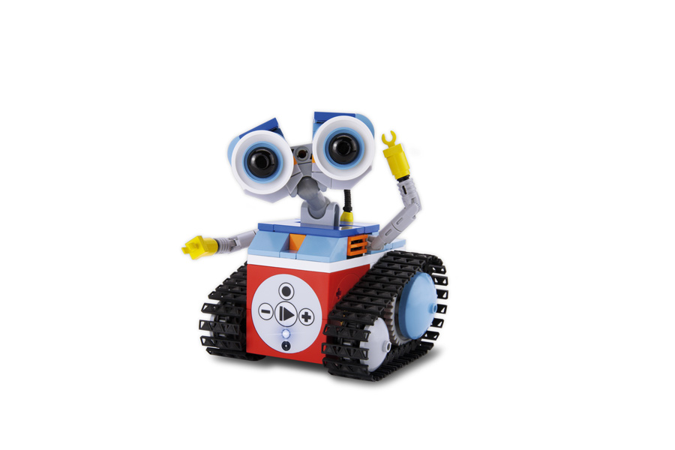
Smart-home is need a smart butler
Butler is a robot like Jarvis of Iron Man or a mini robot

Slide 5
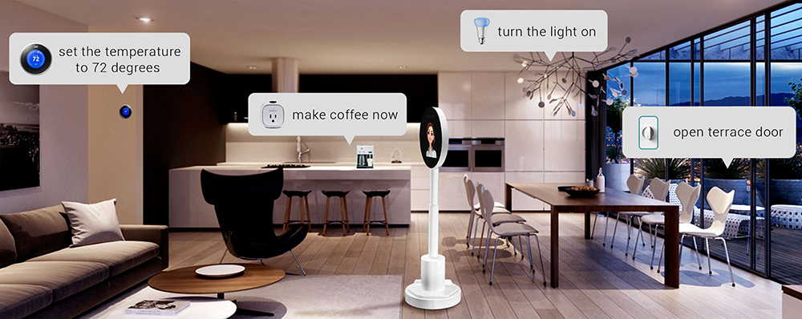
Everything is automatic

Slide 6

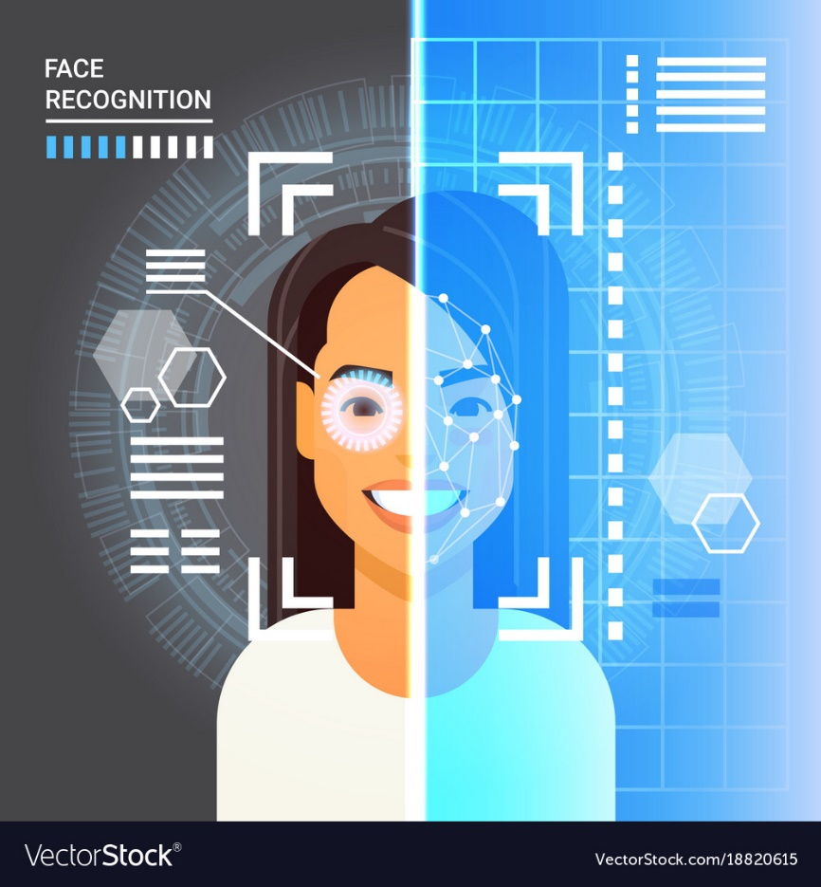
Some systems…
Face recognition system
Automatic fire fight system

Slide 7
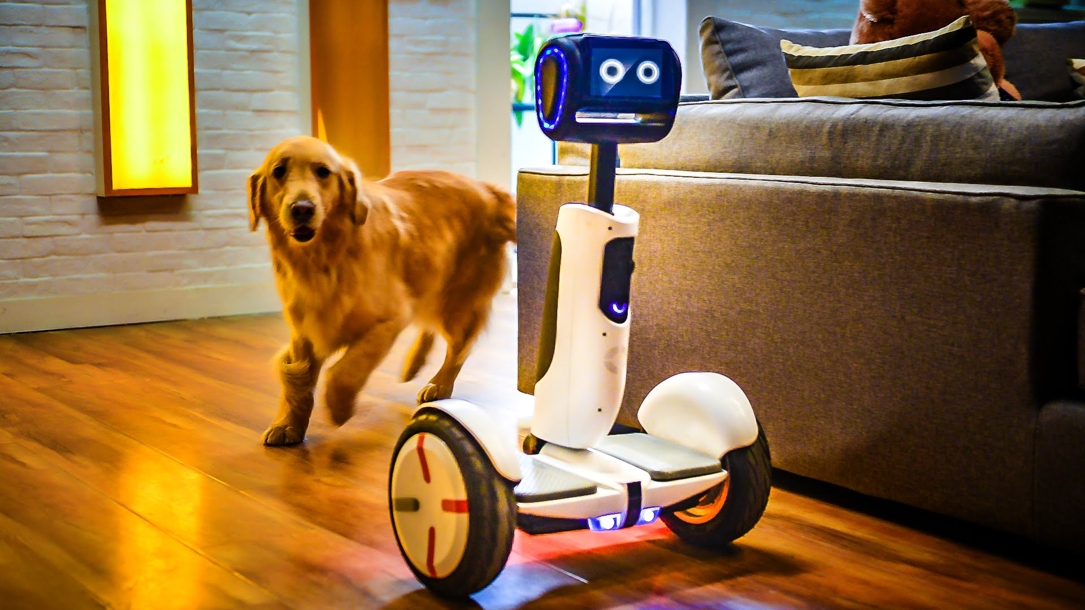
Smart-home with AI is expected to replace today smart-home, It makes your life more convenient, more modern, save resources but still make sure you will be taken care of in full way and the service fee is suitable for everyone. That is the future of Smart-home.

Slide 8
The end
Thanks for listening
ありがとう

